Slide 1
Leinfelden-Echterdingen
June 2018

Slide 2
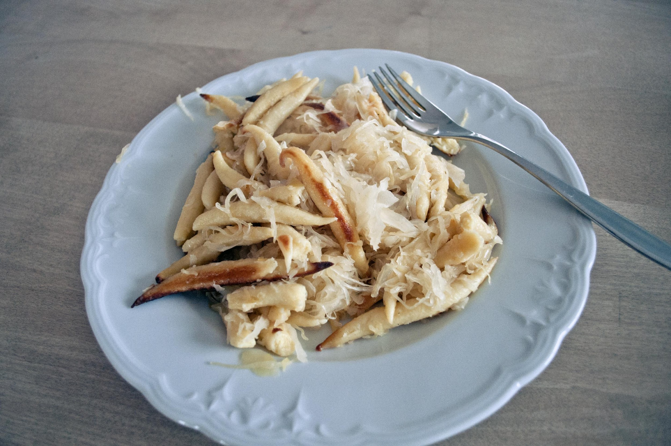
Social Media Requirements
Students will be required to provide a photograph and a brief caption/description of the photo based on the schedule (attached)
Schupfnudeln mit Sauerkraut
Today my host mother made a meal for me at lunch. This food is common in the region of Swabia (Schwaben) and the noodles are sometimes made with potato. They are commonly served with sauerkraut, which is fermented cabbage.

Slide 3
House Guest Etiquette
Bring gifts – Something from York, candy, books, etc
Short showers
Stay tidy
Ask before using/eating
Make sure you voice your opinion if asked what you like/don’t like
Bring family photos
Have advanced contact with families

Slide 4
Budgeting
Currency exchange
Cash on person - 50 euros
Daily spending
Consider funds for food during activities

Slide 5
AAA Travel Cards
Available for students 16 years and older
Parents may get in their name
Younger students could also take a Visa Gift Card

Slide 6
Parent Prep Packet
Copy of Passport
Copy of Visa Card / Travel Card
Flight information
Chair / Co-Chair contact information

